Slide 1
Fundamentals of Computer Architect
Presented by: Han Trung Dinh

Slide 2
References and Evaluation
References:
Kai H., Naresh J., Advanced Computer Architecture - Parallelism, Scalability, Programmability, Mcgraw-Hill, 2008
John L. H., David A. P., Computer Architecture, A Quantitative Approach, 6th edition, Elsevier, 2019
Ata E., Computer Systems - Digital Design, Fundamentals of Computer Architecture and Assembly Language, Springer, 2018
Igor Z. Low-Level Programming - C, Assembly, and Program Execution on Intel® 64 Architecture, Apress 2017
Larry D. P., Modern Assembly Language Programming with the ARM Processor, Elsevier, 2016
Barry B. B., The Intel microprocessors - The Architecture, Programming, and Interfacing, 8th Edition, Prentice Hall, 2008
(*) Note that this course uses a lot of sources from the Internet
Evaluation:
Projects/paper presentation/writing papers: 50%
Final exam: 50%
Prerequisites:
Students should have fundamental knowledge of Computer Architecture

Slide 3
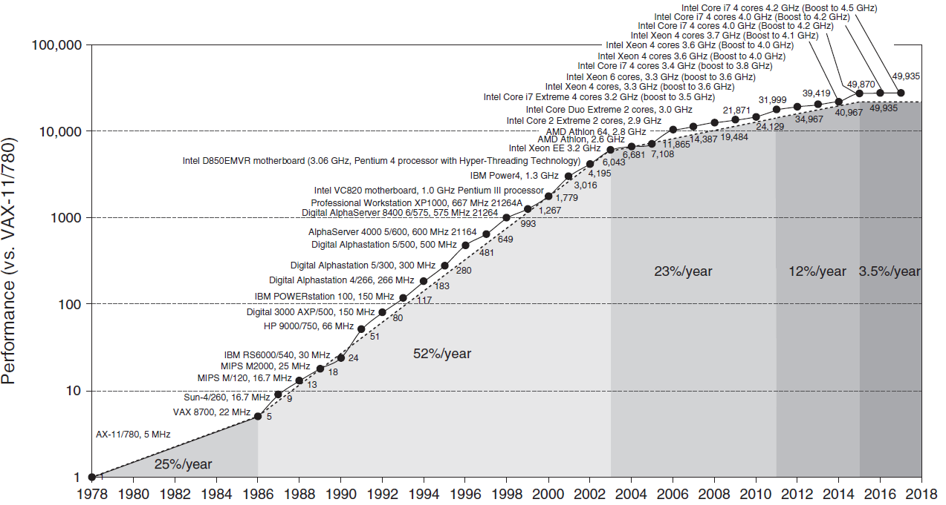
Introduction
Fig. 1.1 Growth in processor performance over 40 years (VAX-11/780 was introduced on 25 October 1977 at Digital Equipment Corporation (DEC))

Slide 4
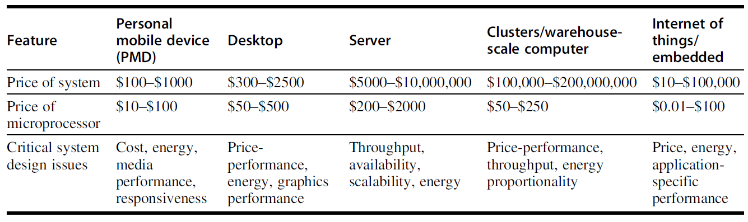
Classes of Computers
Fig. 1.2 A summary of the five mainstream computing classes and their system characteristics

Slide 5
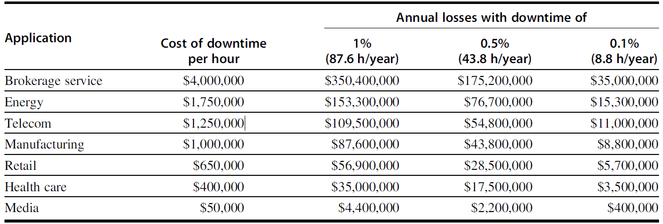
Classes of Computers (cont.)
Fig. 1.3 Costs rounded to nearest $100,000 of an unavailable system are shown by analyzing the cost of downtime

Slide 6
Classes of Parallelism and Parallel Architectures
There are basically two kinds of parallelism
Data-level parallelism (DLP): many data items can be operated concurrently
Task-level parallelism (TLP): tasks can operate independently and largely in parallel
Computer hardware exploits these two parallelism as follows:
Instruction-level parallelism (ILP) exploits DLP at modest levels with compiler help using pipelining and at medium levels using speculative execution
Vector architectures, graphic processor units (GPUs), and multimedia instruction sets exploit DLP by applying a single instruction to a collection of data in parallel
Thread-level parallelism (TLP) exploits either DLP or TLP in a tightly coupled hardware model that allows for interaction between parallel threads
Request-level parallelism (RLP) exploits parallelism among largely decoupled tasks specified by the programmer or the operating system

Slide 7
Classes of Parallelism and Parallel Architectures
Flynn (1966) suggested a simple way for classification
Single instruction stream, single data stream (SISD)—This category is the uniprocessor. The programmer thinks of it as the standard sequential computer, but it can exploit ILP
Single instruction stream, multiple data streams (SIMD)—The same instruction is executed by multiple processors using different data streams. SIMD computers exploit DLP by applying the same operations to multiple items of data in parallel
Multiple instruction streams, single data stream (MISD)—No commercial multiprocessor of this type has been built to date, but it rounds out this simple classification
Multiple instruction streams, multiple data streams (MIMD)—Each processor fetches its own instructions and operates on its own data, and it targets task-level parallelism

Slide 8
Defining Computer Architecture
Determine what attributes are important for a new computer
Design a computer to maximize performance and energy efficiency while staying within cost, power, and availability constraints
Instruction Set Architecture (ISA) design
Functional organization
Logic design
Implementation (encompass integrated circuit design, packaging, power, and cooling)

Slide 9
Instruction Set Architecture (ISA)
ISA serves as the boundary between the software and hardware
E.g.,
80x86
ARM (Advanced RISC Machine), 14.8 billion chips (2015)
RISC-V, a modern RISC developed at the University of California, Berkeley

Slide 10
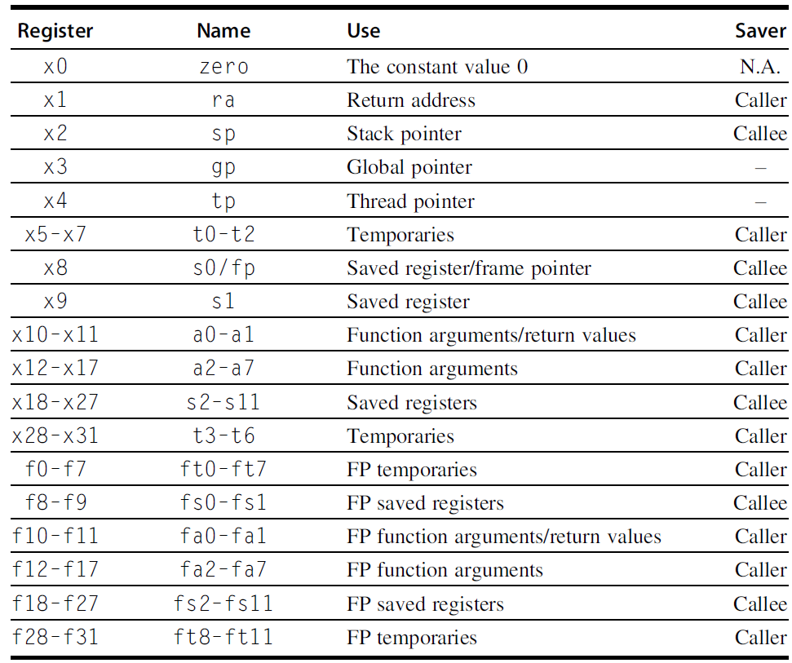
RISC-V Registers
Caller: volatile registers
Callee: non-volatile registers
Fig. 1.4 RISC-V registers, names, usage, and calling conventions

Slide 11
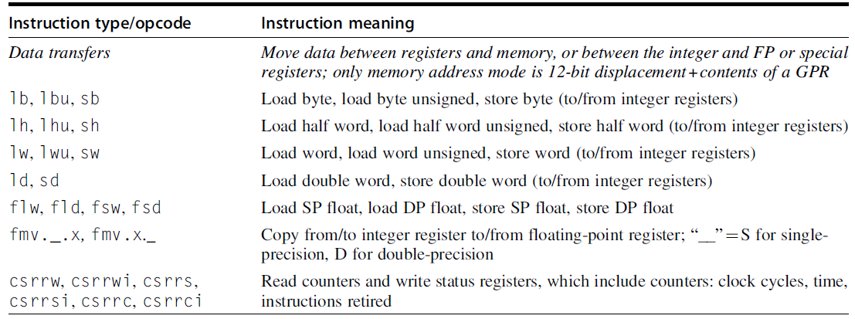
Subset of the instructions in RISC-V (1)
Fig. 1.5.1 Data transfer instructions in RISC-V

Slide 12
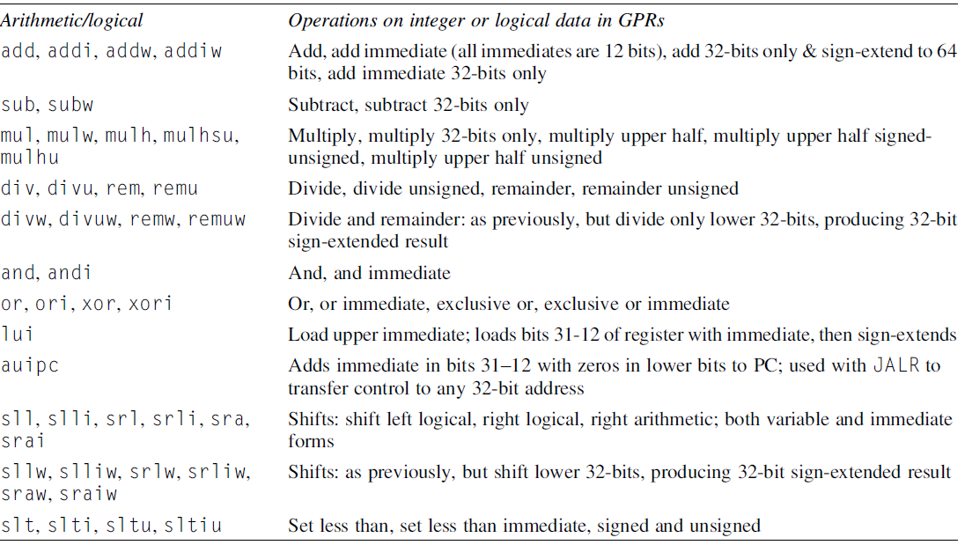
Subset of the instructions in RISC-V (2)
Fig. 1.5.2 Arithmetic/logical instructions in RISC-V

Slide 13
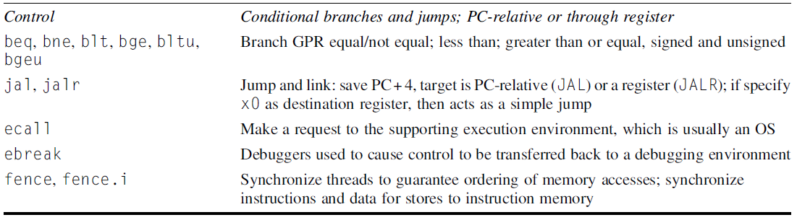
Subset of the instructions in RISC-V (3)
Fig. 1.5.3 Control instructions in RISC-V

Slide 14
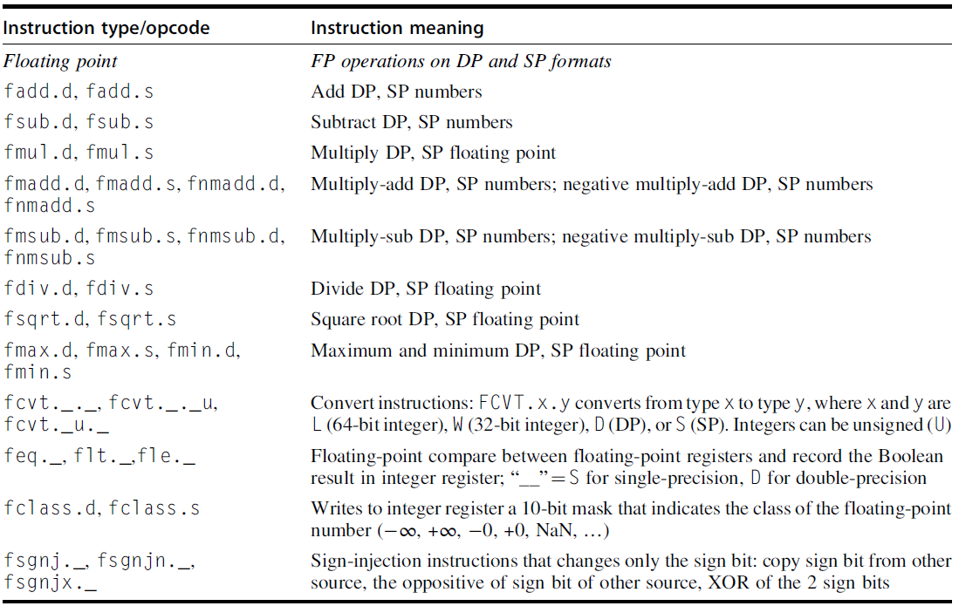
Subset of the instructions in RISC-V (4)
Fig. 1.5.4 Floating point instructions in RISC-V

Slide 15
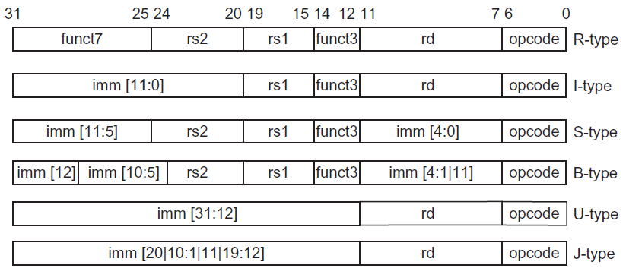
The base RISC-V instruction set architecture formats
Fig. 1.6 RISC ISA Formats
R-type: for integer register-to-register operations, such as ADD, SUB…
I-type: for loads and immediate operations, such as LD and ADDI
B-type: for branches
J-type: for jump and link
S-type: for stores
U-type: for wide immediate instructions (LUI, AUIPC).

Slide 16
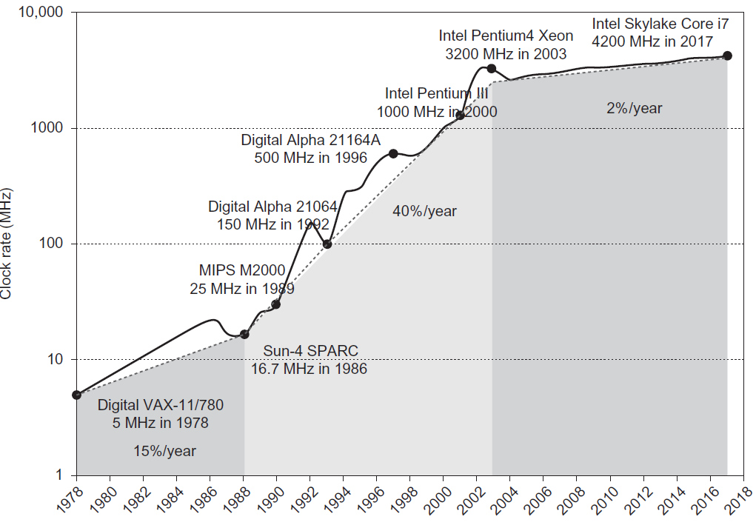
Growth in clock rate of microprocessors
Fig. 1.7 Clock rate improvement

Slide 17
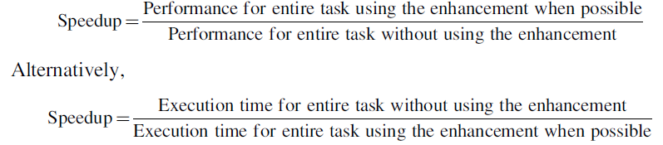
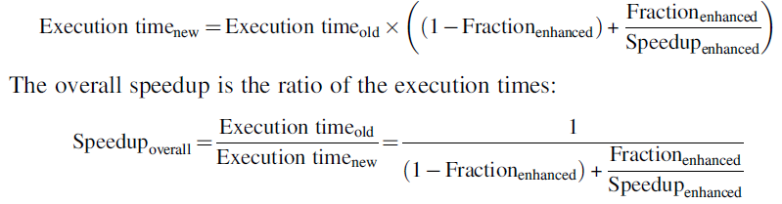
Amdahl’s Law
Amdahl’s Law states that the performance improvement to be gained from using some faster mode of execution is limited by the fraction of the time the faster mode can be used

Slide 18
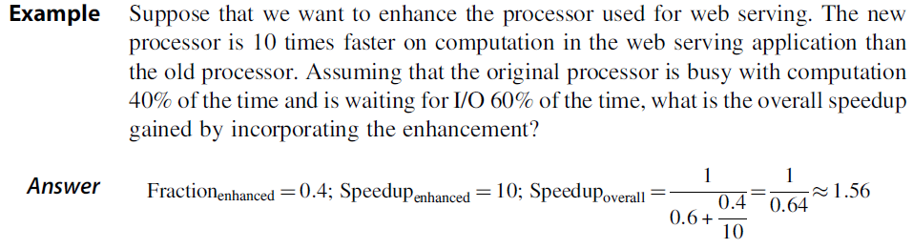
Amdahl’s Lawn (cont.)

Slide 19
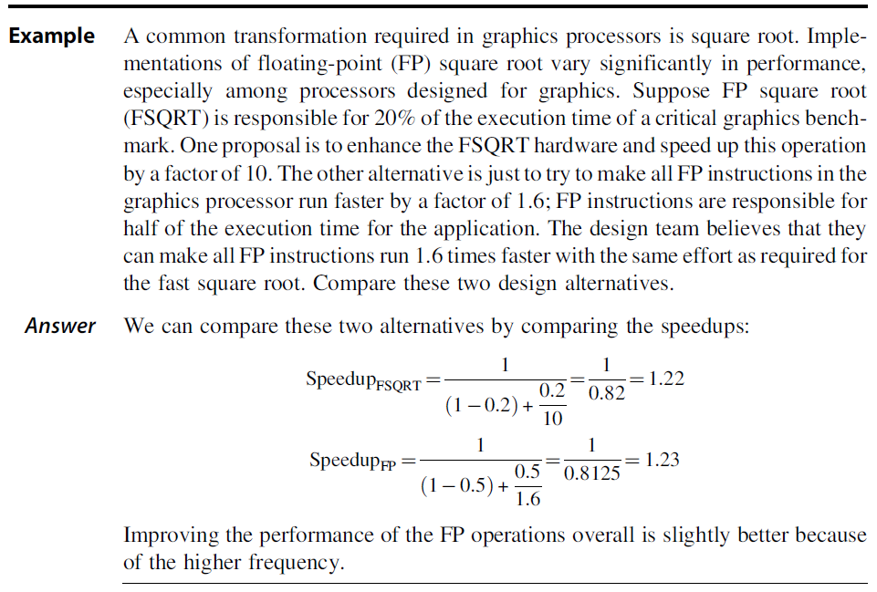
Amdahl’s Lawn (cont.)

Slide 20
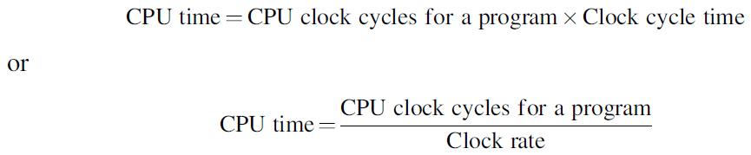
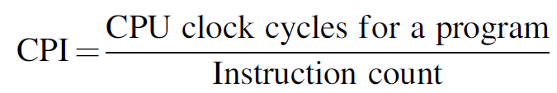
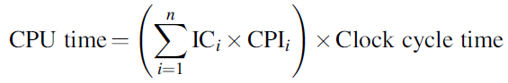
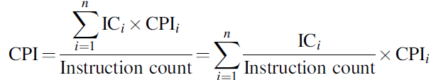
The Processor Performance Equation
CPU time for a program can then be expressed two ways
We can calculate the average number of clock cycles per instruction (CPI)
■ Clock cycle time—Hardware technology and organization
■ CPI—Organization and instruction set architecture
■ Instruction count—Instruction set architecture and compiler technology

Slide 21
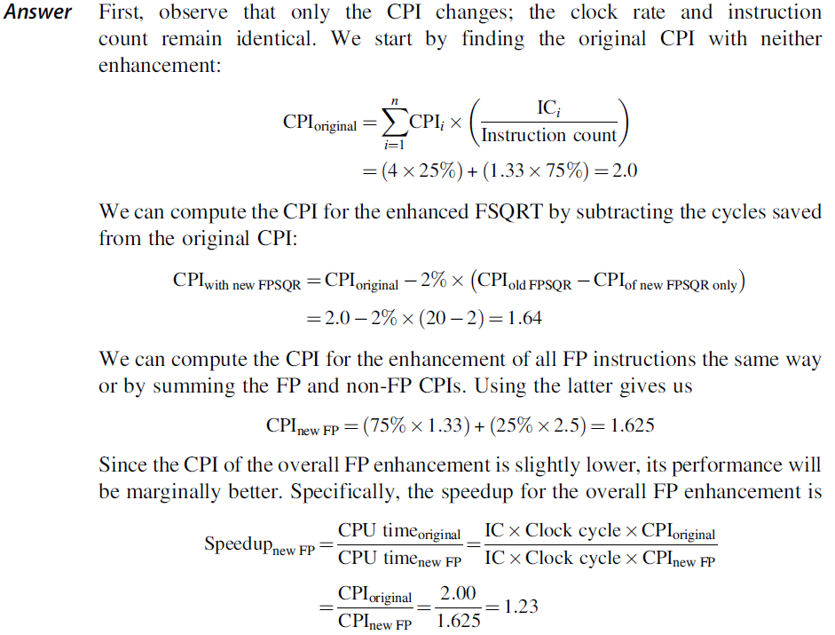
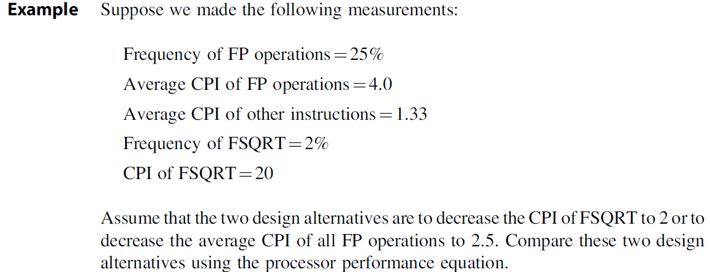
The Processor Performance Equation

Slide 22
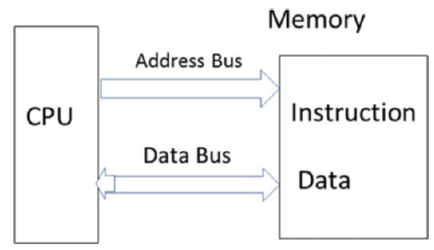
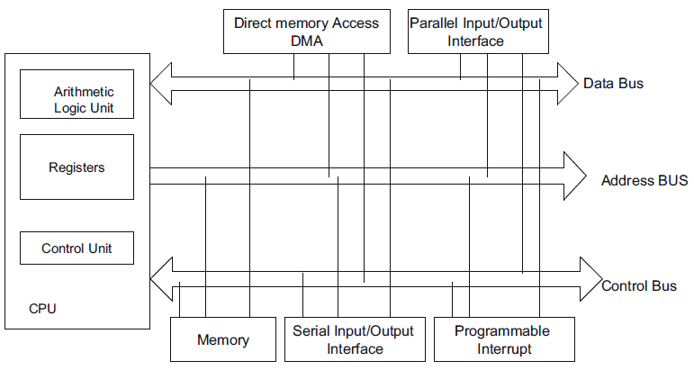
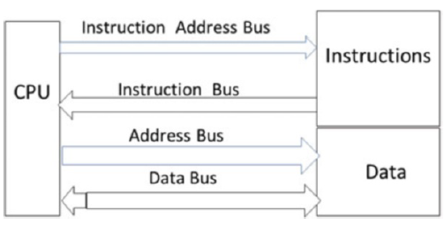
Computer Block Diagram
(a) Von Neumann Architecture
(a) Harvard Architecture
Fig. 1.8 Components of a modern computer

Slide 23
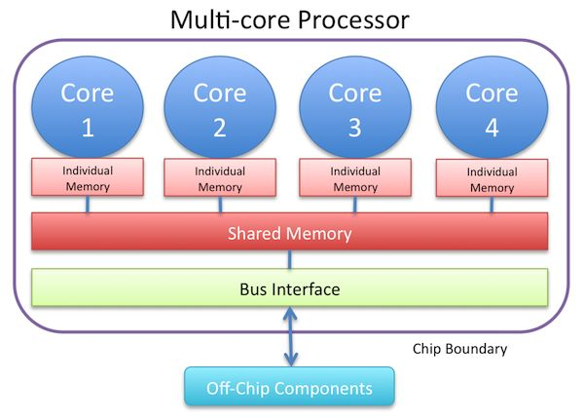
Multicore Processor Architecture

Slide 24
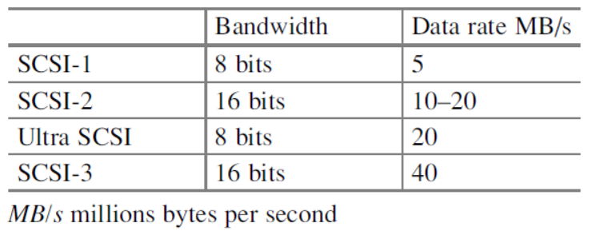
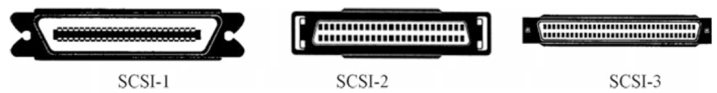
Disk Controller
IDE (integrated disk electronics), ~ 133 MB/s
SATA (Serial Advanced Technology Attachment), upto 6 GB/s
SCSI (small computer systems interface)

Slide 25
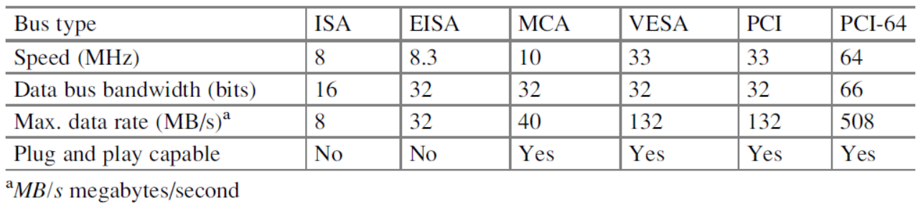
Bus
ISA: Industry Standard Architecture
MCA: MicroChannel Architecture
VESA: Video Electronics Standard Association
PCI: Peripheral Component Interconnect

Slide 26
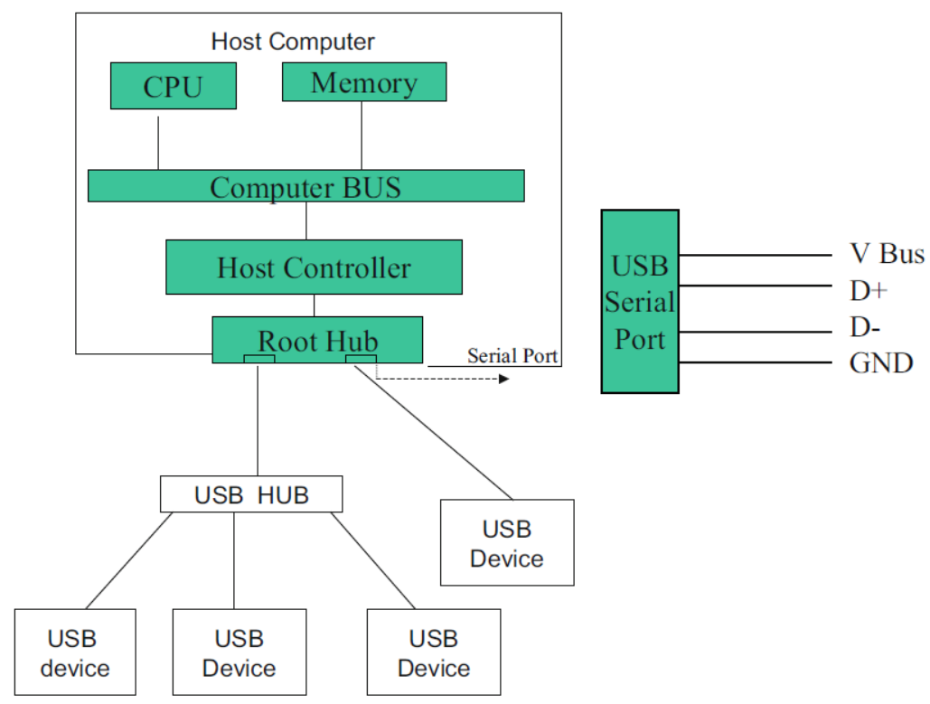
USB architecture

Slide 27
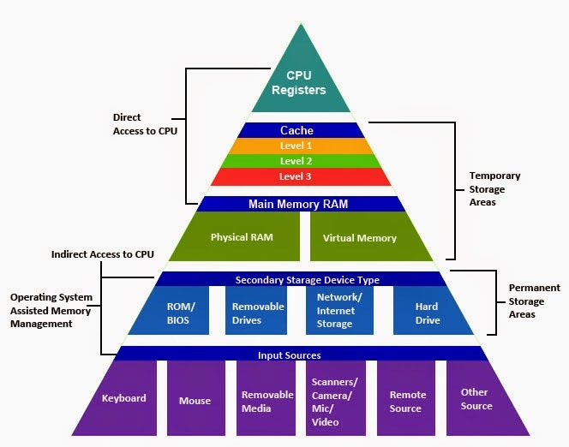
Memory hierarchy

Slide 28
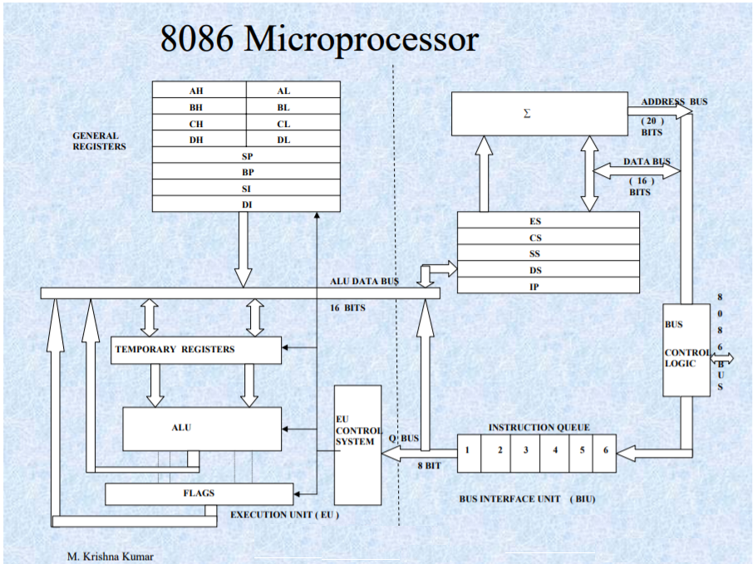
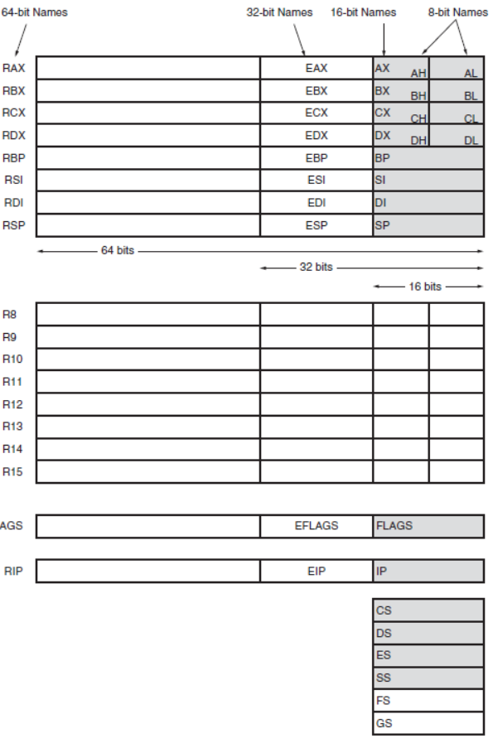
The 8086 through the Core2 microprocessor

Slide 29
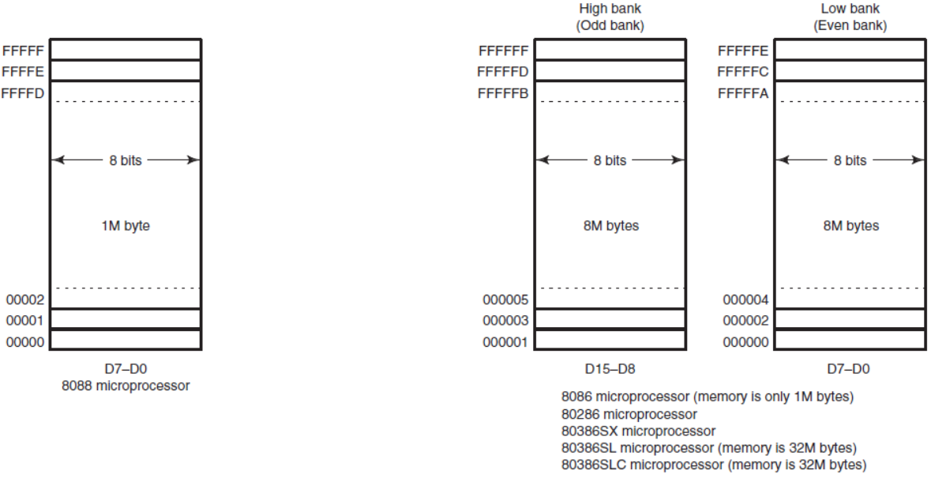
The physical memory systems of the 8086 family

Slide 30
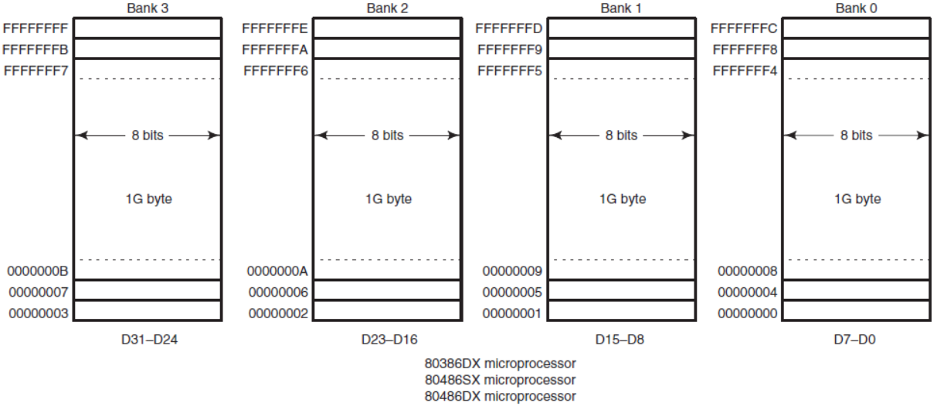
The physical memory systems of the 8086 family (cont.)

Slide 31
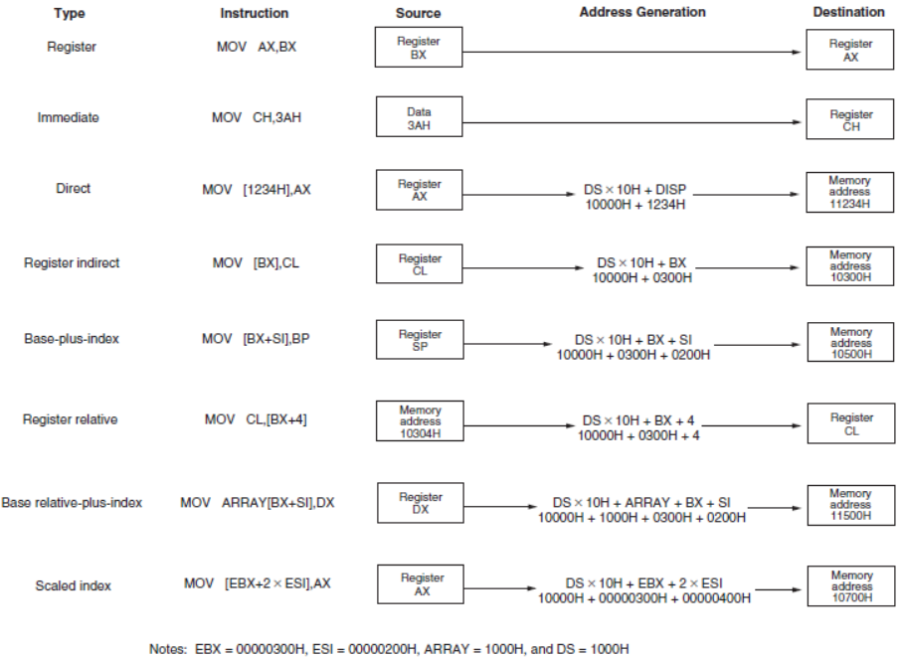
Addressing Modes

Slide 32
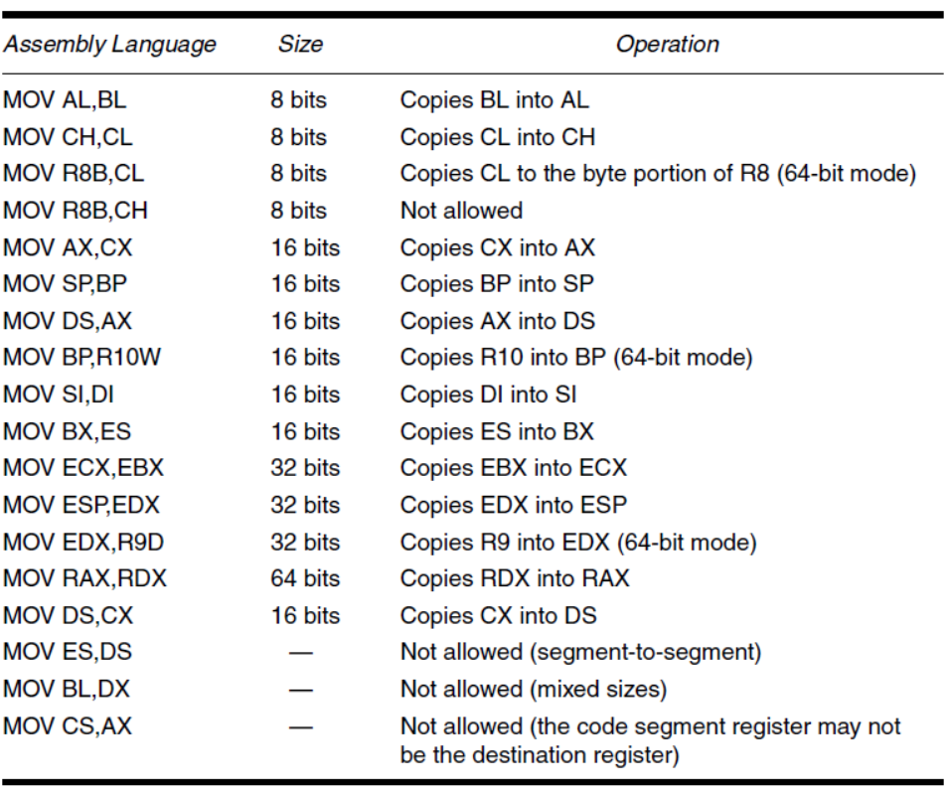
Examples of register-addressed instructions

Slide 33
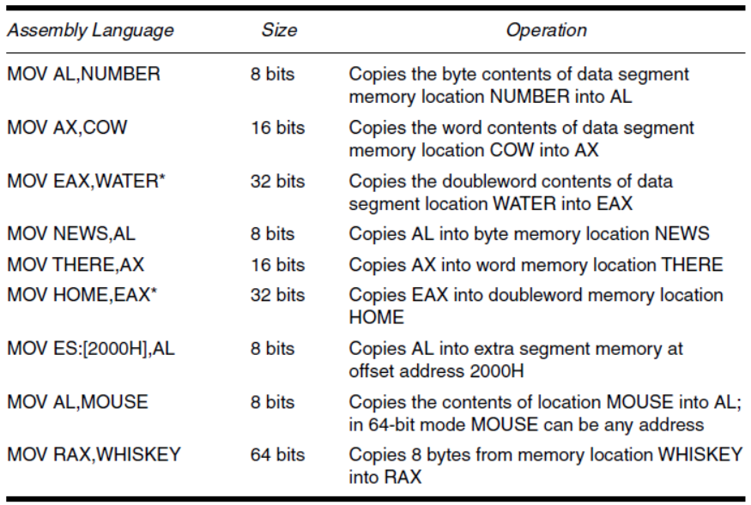
Examples of register indirect addressing

Slide 34
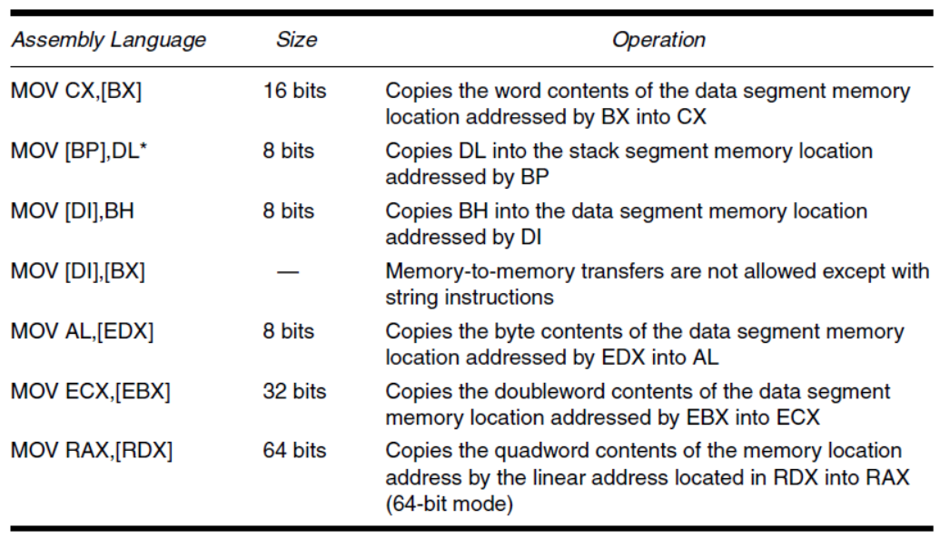

Slide 35
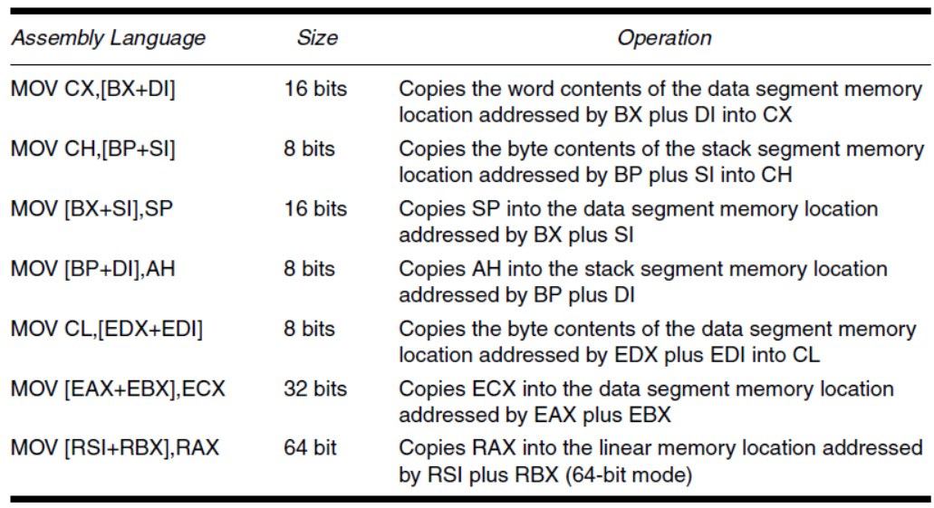
Examples of base-plus-index addressing

Slide 36
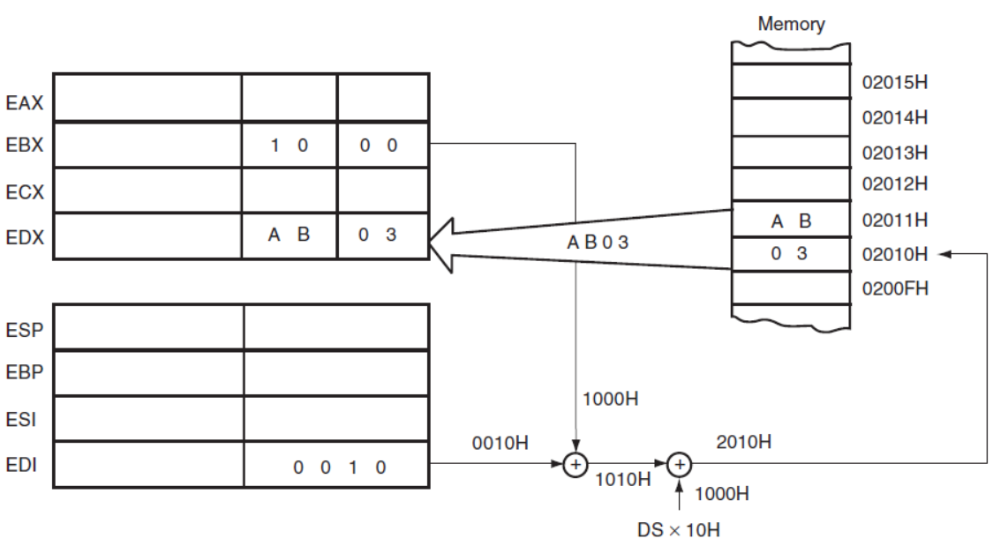
An example showing how the base-plus-index addressing
MOV DX,[ BX + DI]
Notice that memory address 02010H is accessed because DS = 0100H, BX = 100H, and DI = 0010H

Slide 37
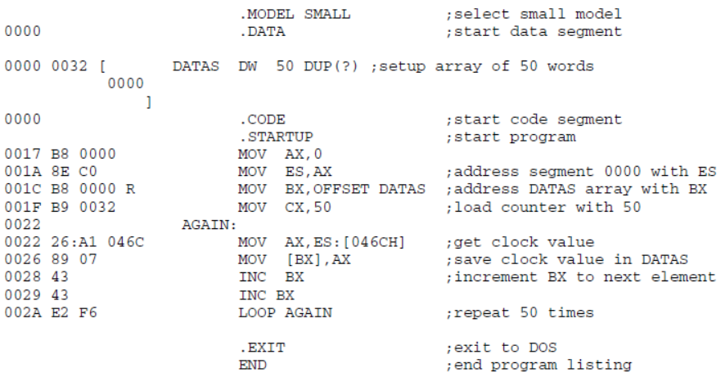
An example of assembly program

Slide 38
What you have learned
Class of Computers
Defining Computer Architecture
Instruction Set Architecture
Amdahl’s Lawn
Processor Performance Equation
Computer Block Diagram
8086 family architect
Disk controller, bus, usb
Addressing modes
Assembly program example

